Slide 1
Problem 14020 - Longest Palindrome Substring –

Slide 2
Outline
Description
Input & Output
Concept & Code
Handle unknown number of testcases
Find the longest palindrome substring

Slide 3
Outline
Description
Input & Output
Concept & Code
Handle unknown number of testcases
Find the longest palindrome substring

Slide 4
Description
Given multiple strings composed of only {'A','T','C','G'}.
That is, for any char c in the strings, c == 'A' or c == 'T' or c== 'C' or c== 'G'.
Find and output the length of the longest palindrome substring in each given string.

Slide 5
Description
Palindrome: a string that is identical to its reverse, like "level" or "aba".
T
C
G
G
C
T
Even length
A
T
C
G
C
T
A
Odd length

Slide 6
Description
Substring: a contiguous sequence of characters within a string.
For “ABCDEFG”,
"ABC" , "CDEF“, "G“ and “ABCDEFG” are substrings.
"ACDE” is not.

Slide 7
Outline
Description
Input & Output
Concept & Code
Handle unknown number of testcases
Find the longest palindrome substring

Slide 8
Input
The input consists of multiple test cases.
Each of the test cases contains a string.

Slide 9
Input Range
It is guaranteed that the length of each given string will not exceed 10000.

Slide 10
Output
For each given string, print the length of the longest palindrome substring of that string, ended with a new line character '\n’.

Slide 11
Sample Test Case
Input:
ATA
ATTTA
ATCGGCTTAA
AAAAAAA
ATCGATCG
AGGGGG
Output:
3
5
6
7
1
5

Slide 12
Outline
Description
Input & Output
Concept & Code
Handle unknown number of testcases
Find the longest palindrome substring

Slide 13
How to handle unknown number of testcases?
Sample input
ATA
ATTTA
ATCGGCTTAA
AAAAAAA
ATCGATCG
AGGGGG
We cannot know the number of testcases.

Slide 14
Handle unknown number of testcases
The return value of scanf()
The function returns the number of items of the argument list successfully filled.
This count can match the expected number of items or be less (even zero) due to a matching failure, a reading error, or the reach of the end-of-file.
If the end-of-file is reached while reading, EOF is returned.
#include <stdio.h>
int main(void)
{
char str[10002];
return 0;
}
while (scanf("%s", str) != EOF) { /*Ctrl Z + Enter in console mode*/
}

Slide 15
Outline
Description
Input & Output
Concept & Code
Handle unknown number of testcases
Find the longest palindrome substring

Slide 16
Method 1 – Brute Force
Use a for loop to try all possible substring beginning positions.
i is the beginning position of substrings.
for (i = ???; i < ???; i++)
{
for (j = ???; j >= ???; j--)
{
for(k = ???; k <= ???; k++)
{
// check if str[i...j] is palindrome or not
}
}
}
Use another for loop to try all possible substring ending positions.
j is the ending position of substrings.
i
i = 0
i
j
i = 1
j
j = length - 1
j = length - 2
A | B | C | D | E | F

Slide 17
Method 1 – Brute Force
Use a for loop to try all possible substring beginning positions.
i is the beginning position of substrings.
for (i = 0; i < length; i++)
{
for (j = length - 1; j >= i; j--)
{
for(k = ???, l = ???; ???; k++, l--)
{
// check if str[i...j] is palindrome or not
}
}
}
Use another for loop to try all possible substring ending positions.
j is the ending position of substrings.
k > l STOP
i
j
i = 0
A | B | C | B | A | F
j = length - 2
k++
l--
l k
k l
k=l
k l
str[k] == str[l]?
Inside the second loop, just check if the substring str[i ... j] is a palindrome or not.
k and l are the positions you want to check.

Slide 18
Method 1 – Brute Force
Use a for loop to try all possible substring beginning positions.
i is the beginning position of substrings.
for (i = 0; i < length; i++)
{
for (j = length - 1; j >= i; j--)
{
is_pal = 1;
for(k = i, l = j; k <= l; k++, l--)
{
// check if str[i...j] is palindrome or not
if( str[k] != str[l] )
{
is_pal = 0;
break;
}
}
}
}
Use another for loop to try all possible substring ending positions.
j is the ending position of substrings.
Inside the second loop, just check if the substring str[i ... j] is a palindrome or not.

Slide 19
Method 1 – Brute Force
for (i = 0; i < length; i++)
{
for (j = length - 1; j >= i; j--)
{
is_pal = 1;
for(k = i, l = j; k <= l; k++, l--)
{
// check if str[i...j] is palindrome or not
if( str[k] != str[l] )
{
is_pal = 0;
break;
}
}
if( is_pal && j - i + 1 > max_len) max_len = j - i + 1;
}
}
printf("%d\n", max_len);
}
return 0;
}
#include <stdio.h>
#include <string.h>
int main(void)
{
char str[10002];
int length, max_len;
int i, j, k, l;
int is_pal;
while( scanf("%s", str) != EOF )
{
length = strlen(str);
max_len = 0;
Record the length of the longest
palindrome substring so far.

Slide 20

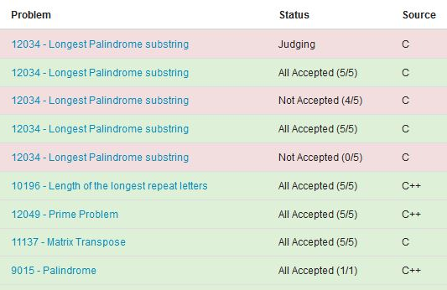
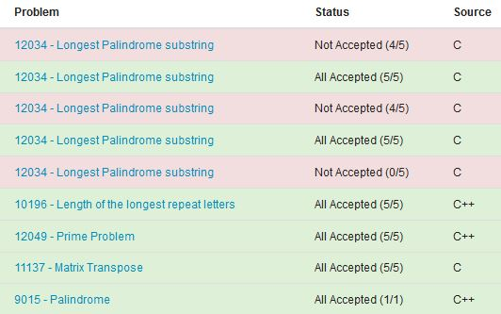

Slide 21
Weakness of the brute force method
A substring: ATCGGCCTA
During the checking of the substring, we notice that ‘G’–‘C’ pair is not matching, and thus, the substring “ATCGGCCTA” is not a palindrome substring.
A
T
C
G
G
C
G
C
C
T
A
i
j
However, in the brute force method, we will still test these substrings again.
After the checking process, these 3 substrings have already been found to be not palindromes as well.
Note that all these substrings share a common “center” G.

Slide 22
Method 2 – A Center-Based Method
Input: ATCTACTTAA
Try all possible palindrome substring centers.
Center
Center
Center
Center
. . .
A
T
C
T
A
C
T
T
A
A
These are odd length cases.

Slide 23
Example
For even length cases.
Input: ATCTACTTAA
Centers
Centers
. . .
Centers
A
T
C
T
A
C
T
T
A
A
X

Slide 24
Method 2 – Center-based
Use a loop to try possible palindrome centers i.
Assume that the length of a possible palindrome is odd. Expand towards left and right sides until it cannot form a palindrome.
for (i = 0; i < length; i++)
{
// odd length
for(j = ???, k = ???; j >= ??? && k < ???; j--, k++)
{
}
// even length
for(j = i, k = i + 1; j >= 0 && k < length; j--, k++)
{
}
}
Expand
i-1
i
i+1
j k
idx: i
k = j = i
k++
j--
We want to check if str[k] == str[j]
Assume that the length of a possible palindrome is even.

Slide 25
Method 2 – Center-based
Use a loop to try possible palindrome centers i.
Assume that the length of a possible palindrome is odd. Expand towards left and right sides until it cannot form a palindrome.
for (i = 0; i < length; i++)
{
// odd length
for(j = i, k = i; j >= 0 && k < length; j--, k++)
{
if(str[j] != str[k]) break;
if(k - j + 1 > max_len) max_len = k - j + 1;
}
// even length
for(j = i, k = i + 1; j >= 0 && k < length; j--, k++)
{
}
}
Expand
i-1
i
i+1
j k
idx: i
k = j = i
k++
j--
We want to check if str[k] == str[j]
Assume that the length of a possible palindrome is even.

Slide 26
Method 2 – Center-based
Use a loop to try possible palindrome centers i.
Assume that the length of a possible palindrome is odd. Expand towards left and right sides until it cannot form a palindrome.
for (i = 0; i < length; i++)
{
// odd length
for(j = i, k = i; j >= 0 && k < length; j--, k++)
{
if(str[j] != str[k]) break;
if(k - j + 1 > max_len) max_len = k - j + 1;
}
// even length
for(j = ???, k = ???; j >= ??? && k < ???; j--, k++)
{
}
}
Expand
i-1
i
i+1
idx: i
Assume that the length of a possible palindrome is even.
Expand
j--
k++
i
i+1
idx: i
j
idx: i+1
k

Slide 27
Method 2 – Center-based
Use a loop to try possible palindrome centers i.
Assume that the length of a possible palindrome is odd. Expand towards left and right sides until it cannot form a palindrome.
for (i = 0; i < length; i++)
{
// odd length
for(j = i, k = i; j >= 0 && k < length; j--, k++)
{
if(str[j] != str[k]) break;
if(k - j + 1 > max_len) max_len = k - j + 1;
}
// even length
for(j = i, k = i + 1; j >= 0 && k < length; j--, k++)
{
if(str[j] != str[k]) break;
if(k - j + 1 > max_len) max_len = k - j + 1;
}
}
Expand
i-1
i
i+1
idx: i
Assume that the length of a possible palindrome is even.
Expand
j--
k++
i
i+1
idx: i
j
idx: i+1
k

Slide 28
Method 2 – Center-based
for (i = 0; i < length; i++)
{
// odd length
for(j = i, k = i; j >= 0 && k < length; j--, k++)
{
if(str[j] != str[k]) break;
if(k - j + 1 > max_len) max_len = k - j + 1;
}
// even length
for(j = i, k = i + 1; j >= 0 && k < length; j--, k++)
{
if(str[j] != str[k]) break;
if(k - j + 1 > max_len) max_len = k - j + 1;
}
}
printf("%d\n", max_len);
}
return 0;
}
#include <stdio.h>
#include <string.h>
int main(void)
{
char str[10002];
int length, max_len, i, j, k;
while( scanf("%s", str) != EOF )
{
length = strlen(str);
max_len = 0;

Slide 29
What’s difference?
Method 1 needs a three-layer loop to solve the problem. It will take a lot of time to try all possible palindromes. (bad)
Method 2 just needs a two-layer loop to get the answer: outer loop goes through the whole string; inner one tries to expand. (better)
Is there another method faster than Method 2?

Slide 30
Method 3 – Manacher's Algorithm
Reference I (English introduction):
https://articles.leetcode.com/longest-palindromic-substring-part-ii/
Reference II (Chinese introduction):
http://www.csie.ntnu.edu.tw/~u91029/Palindrome.html#3
It takes only O(n) to solve this problem, but we don’t introduce it here.

